Slide 1

Memory

Slide 2
Memory

Slide 3
RAM
0
1
0
1
0
1
0
1
0
1
1
0
1
1
0
0
0
0
2
1
1
0
1
0
0
1
1
4
3
1
0
1
1
1
1
0
1
Address In
4
1
0
1
1
0
0
0
1
1
0
1
1
0
0
0
1
5
1
1
1
0
1
1
0
0
1
0
1
1
0
0
0
1
Data Out

Slide 4
Memory
64x8 RAM
A3 D7
A2 D6
A1 D5
A0 D4
D3
D2
D1
Write D0

Slide 5
8x4 RAM
Address
Data
000
001
010
011
100
101
110
111
A2
A1
A0

Slide 6
8x4 RAM
In3 In2 In1 In0
Write
000
001
010
011
100
101
110
111
3:8
Decoder
Enable
S2 S1 S0
A2
A1
A0

Slide 7
Static RAM Organization
1024 x 4 SRAM
CS
Chip Select Line (active lo)
Write Enable Line (active lo)
10 Address Lines
4 Bidirectional Data Lines
WE
A9
A8
A7
IO3
A6
IO2
A5
IO1
A4
IO0
A3
A2
A1
A0

Slide 8
RAM Organization
Long thin layouts are not the best organization for a RAM
A9
Address
A8
Buffers
Storage Matrix
Storage Array
Some Addr
bits select
row
A7
64 x 64
Square
Array
A6
A5
64 x 16
64 x 16
64 x 16
64 x 16
Row
A4
Decoders
A3
Address
Some Addr
bits select
within row
A2
Buffers
Amplifers &
Mux/Demux
Sense Amplifiers
A1
Column
A0
Decoders
CS
Data Buffers
WE
I/O0
I/O1
I/O2
I/O3

Slide 9
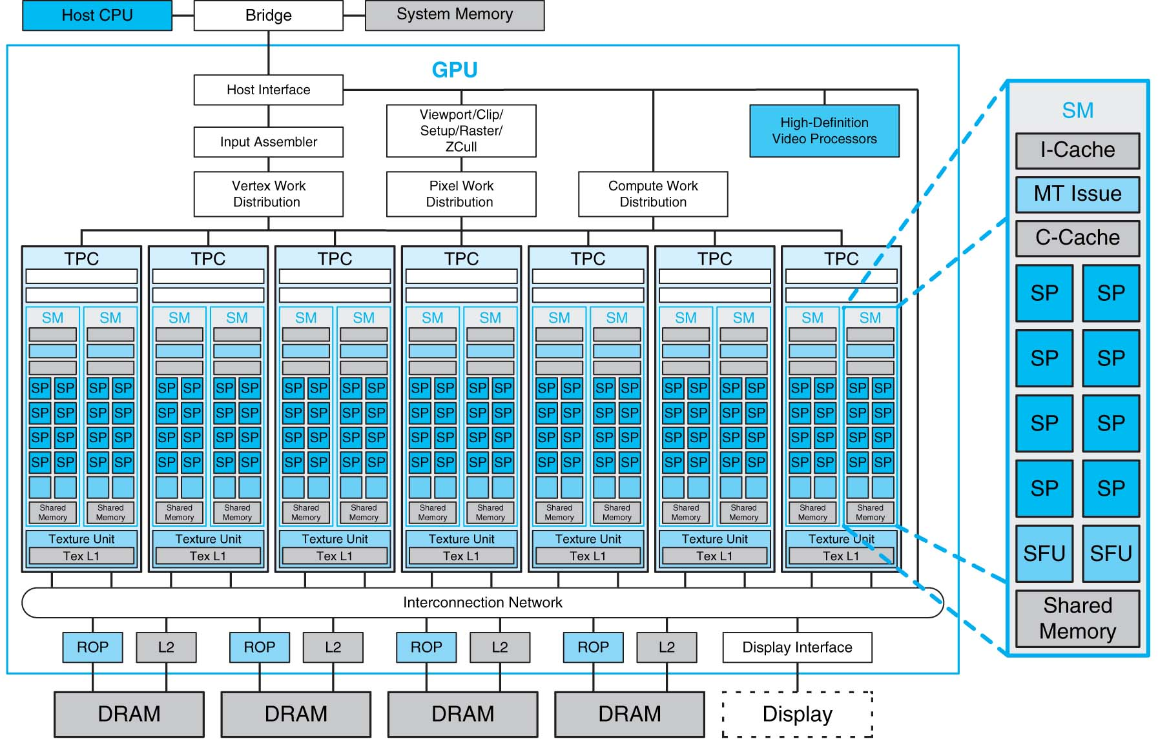
Processor Array

Slide 10
1Kx 1 bit RAM Organization
5-bit row
address
W
0
W
1
32 x 32 memory cell array
5-bit decoder
W
Sense/Write circuitry
31
10-bit
address
32-to-1
R
/
W
output multiplexer
and
CS
input demultiplexer
5-bit column address
Data input/output (1 bit)
Organization of a 1K × 1 memory chip.

Slide 11
Memory Access Timing: the Big Picture
Timing:
Send address on the address lines, wait for the word line to become stable
Read/write data on the data lines
Read Cycle
READ
Read Access
Read Access
Write Cycle
WRITE
Write Access
Data Valid
Data Written
DATA

Slide 12
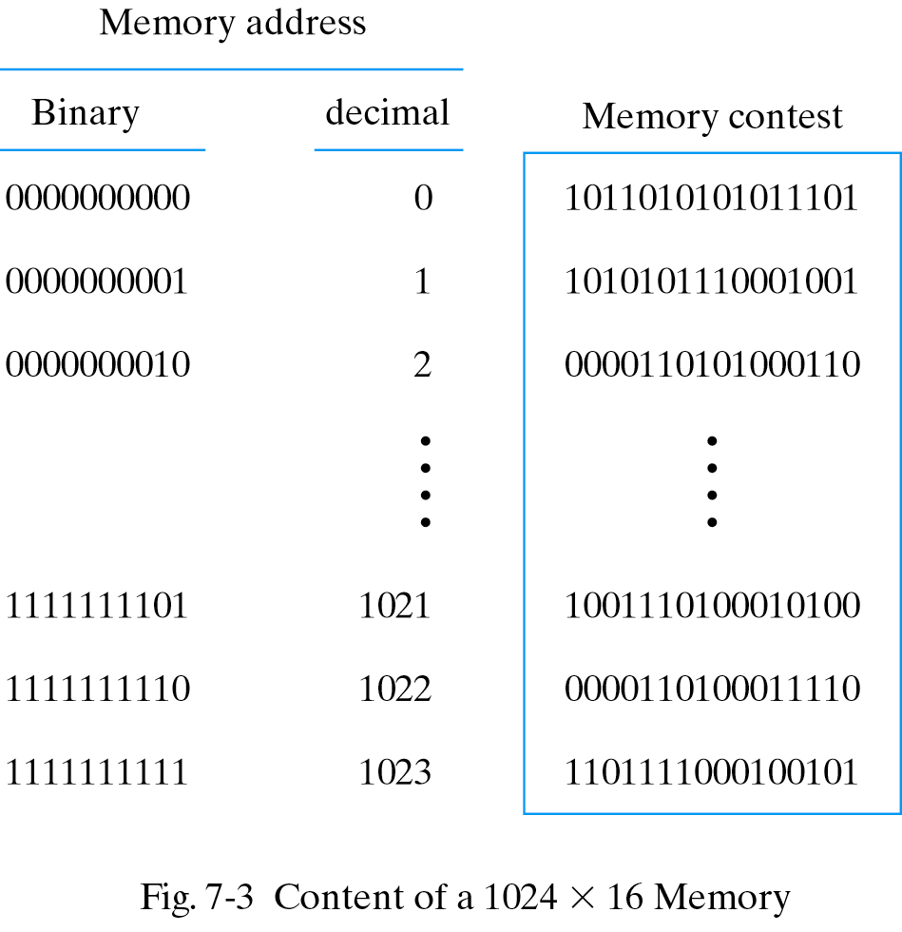
Content of a memory
Each word in memory is assigned an identification number, called an address, starting from 0 up to 2^{k}-1, where k is the number of address lines.
The number of words in a memory with one of the letters K=2¹⁰, M=2²⁰, or G=2³⁰.
64K = 2¹⁶ 2M = 2²¹
4G = 2³²
1024x16 Memory Module

Slide 13
Memory Cell Array Access Example
word=16-bit wide(N), row=8 words(L), address=10 bits (k)
Accessing word 9= 0000001001₂
L=8 words
S_{0..7}
S_{8..15}
Word 0
Word 1
. . .
Word 7
1
A₃
Word 8
Word 9
. . .
Word 15
S_{16..23}
Word 16
Word 17
. . .
Word 23
0
A₄
Row Decoder
. . .
. . .
. . .
. . .
0
M/L =
1024/8=
128 rows
…
...
0
A₉
S₁₀₁₆₋₁₀₂₃
Word 1016
. . .
. . .
Word 1023
16 bits
16 bits
. . .
16 bits
SAmp/Drv
SAmp/Drv
. . .
SAmp/Drv
1
A₀
16 bits
16 bits
. . .
16 bits
0
A₁
Column Decoder + MUX
0
A₂
16 bits

Slide 14
Memory Structures
Taking the idea one step further
Shorter wires within each block
Enable only one block addr decoder➔ power savings
Row Address
Column
Address
Block
Address
Blk EN
Blk EN
Blk EN
Blk EN
Global Bus
SAmp/ Drv
Global drivers/ sense amplifiers

Slide 15
Larger Memories Using Multiple Chips
512K x 8 memory chip
19 bit address on chip
8-bit data input/output
chip select (2 bits)
Question ? Design a 2Mx32 given: 512kx8

Slide 16
19-bit internal chip address
A
0
21-bit addresses
A
18
A
19
A
20
16 chips
2-bit decoder
512K x 8 memory chip
D
31-24
D
23-16
D
15-8
D
7-0
Organization of a 2M × 32 memory module using 512K × 8 static memory chips (16 chips).

Slide 17
19-bit internal chip address
A
0
4 chips for each 32 bit word
A
18
A
D
31-24
D
23-16
D
15-8
D
7-0
512K x 8 memory chip
Organization of a 2M × 32 memory module using 512K × 8 static memory chips (16 chips).

Slide 18
19-bit internal chip address
A
0
21-bit addresses
A
18
A
19
A
20
16 chips
2-bit decoder
512K x 8 memory chip
D
31-24
D
23-16
D
15-8
D
7-0
Organization of a 2M × 32 memory module using 512K × 8 static memory chips (16 chips).

Slide 19
Random Access Memory (RAM)
RAM – Readable and writable memory
“Random access memory”
Strange name—Created several decades ago to contrast with sequentially-accessed storage like tape drives
Logically same as register file—Memory with address inputs, data inputs/outputs, and control
RAM usually one port; RF usually two or more
RAM vs. RF
RAM typically larger than about 512 or 1024 words
RAM typically stores bits using a bit storage approach that is more efficient than a flip-flop
RAM typically implemented on a chip in a square rather than rectangular shape—keeps longest wires (hence delay) short
32
32
W_data
R_data
4
4
W_addr
R_addr
W_en
R_en
16
×
32
register file
32
data
10
addr
1024
×
32
r
w
R
A
M
en
RAM block symbol

Slide 20


Simplest circuits with feedback
Two inverters form a static memory cell
will hold value as long as it has power applied
How to get a new value into the memory cell?
selectively break feedback path
load new value into cell
"1"
"stored value"
"0"
"remember"
"load"
"stored value"
"data"

Slide 21
Implementing Registers in CMOS
Uses transmission gate
When “WR” asserted, “write” operation will take place
Stack D latch structures to get n-bit register
WR
Q
Q
D
WR
WR
WR

Slide 22
RAM Internal Structure
Let A = log₂M
wdata(N-1)
wdata(N-2)
wdata0
32
data
10
word
bit storage
addr
1024x32
enable
block
r
w
RAM
d0
(aka “cell”)
en
addr0
a0
w
o
r
d
addr1
a1
AxM
d1
decoder
addr(A-1)
a(A-1)
data cell
d(M-1)
word
word
Combining rd and wr data lines
clk
e
enable
enable
en
r
w
data
r
w
to all cells
RAM cell
rdata(N-1)
rdata(N-2)
rdata0
Similar internal structure as register file
Decoder enables appropriate word based on address inputs
rw controls whether cell is written or read
rd and wr data lines typically combined
Let’s see what’s inside each RAM cell

Slide 23
Static RAM (SRAM)
SRAM cell
data
data’
d
cell
32
data
d’
10
addr
1024x32
a
r
w
RAM
en
word
0
enable
SRAM cell
“Static” RAM cell
6 transistors (recall inverter is 2 transistors)
Writing this cell
word enable input comes from decoder
When 0, value d loops around inverters
That loop is where a bit stays stored
When 1, the data bit value enters the loop
data is the bit to be stored in this cell
data’ enters on other side
Example shows a “1” being written into cell
data
data’
1
0
d
a
1
0
word
1
enable
data
data’
d
cell
1
d’
0
a
word
0
enable

Slide 24
Static RAM (SRAM)
32
data
10
addr
r
w
1024x32
RAM
en
SRAM cell
“Static” RAM cell
Reading this cell
Somewhat trickier
When rw set to read, the RAM logic sets both data and data’ to 1
The stored bit d will pull either the left line or the right bit down slightly below 1
“Sense amplifiers” detect which side is slightly pulled down
The electrical description of SRAM is really beyond our scope – just general idea here, mainly to contrast with DRAM...
data
data’
1
1
d
1
0
a
word
1
1
<1
enable
To sense amplifiers

Slide 25
SRAM Column Example
Read
Write

Slide 26
Dynamic RAM (DRAM)
32
data
10
addr
r
w
1024x32
RAM
en
DRAM cell
data
“Dynamic” RAM cell
1 transistor (rather than 6)
Relies on large capacitor to store bit
Write: Transistor conducts, data voltage level gets stored on top plate of capacitor
Read: Just look at value of d
Problem: Capacitor discharges over time
Must “refresh” regularly, by reading d and then writing it right back
c
ell
word
enable
d
capacitor
slowly
discharging
(
a
)
data
enable
d
discharges
(
b
)

Slide 27
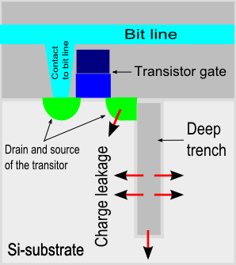
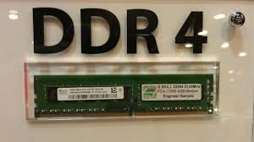
Dynamic RAM (DRAM)
DRAM cell
“Dynamic” RAM cell
1 transistor (rather than 6)
Relies on capacitor to store bit
bit
c
ell
word
enable
d
capacitor
slowly
discharging
(
a
)
bit
SDRAM DDR1 DDR2 DDR3 DDR4
enable
d
discharges
(
b
)
66-133 200-400 400-800 800-2133 1600-3200
1999 2000 2006 2010 2014
Notes:
The state of the art DRAM cell only has one transistor/1C. The bit is stored in a tiny transistor.
The write operation is very simple. Just drive the bit line and select the row by turning on this pass transistor.
For read, we will need to precharge this bit line to high and then turn on the pass transistor.
This will cause a small voltage change on the bit line and a very sensitive amplifier will be used to measure this small voltage change with respect to a reference bit line.
Once again, the value we stored will be destroyed by the read operation so an automatic write back has to be performed at the end of every read.
Similar to SRAM, DRAM is organized into rows and columns.
But unlike SRAM, which allows you to read an entire row out at a time at a word, classical DRAM only allows you read out one-bit at time time.
The reason for this is to save power as well as area. Remember now the DRAM cell is very small we have a lot of them across horizontally.
So it will be very difficult to build a Sense Amplifier for each column due to the area constraint not to mention having a sense amplifier per column will consume a lot of power.
You select the bit you want to read or write by supplying a Row and then a Column address.
Similar to SRAM, each row control line is referred to as the word line and each vertical data line is referred to as the bit line.

Slide 28
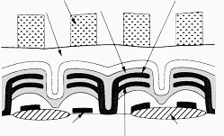
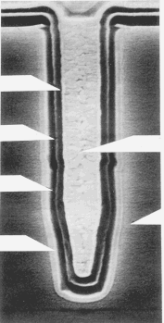
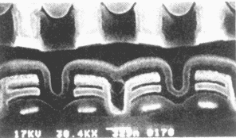
Dynamic RAM 1-Transistor Cell: Layout
Capacitor
Dielectric
layer
Word line
Insulating Layer
Cell plate
Cell Plate Si
Transfer gate
Isolation
Capacitor Insulator
Refilling Poly
Storage electrode
Storage Node Poly
Si Substrate
2nd Field Oxide
Trench Cell
Stacked-capacitor Cell

Slide 29
Comparing Memory
Register file
Fastest
But biggest size
SRAM
Fast
More compact than register file
DRAM
Slowest (capacitor)
And refreshing takes time
But very compact (lower cost)
Use register file for small items, SRAM for large items, and DRAM for huge items
Note: DRAM’s big capacitor requires a special chip design process, so DRAM is often a separate chip
MxN Memory
implemented as a:
register
file
SRAM
DRAM
Size comparison for same
number of bits (not to scale)

Slide 30
Memory controller does the multiplexing of row and column and issues strobe signals
Processor sends all bits of address
Row/Column address
Address
R
A
S
R
/
W
Memory
C
A
S
Request
controller
R
/
W
Memory
Processor
CS
Clock
Clock
Data
Use of a memory controller.

Slide 31
Row/Column address
Address
R
A
S
R
/
W
Memory
C
A
S
Request
controller
R
/
W
Memory
Processor
CS
Clock
Clock
Data
Memory controller provides the refresh control if not done on the chip
Refreshing typically once every 64 ms. At a cost of .2ms
Less than .4% overhead
Use of a memory controller.

Slide 32
CAM
CAM vs. RAM
Data In
0
1
0
1
0
1
0
1
0
1
0
1
1
0
0
0
1
1
1
0
1
1
0
0
0
0
2
1
1
0
1
0
0
1
1
0
1
0
1
0
1
0
1
0
3
1
0
1
1
1
1
0
1
1
1
0
1
1
0
0
0
0
4
Address In
4
1
0
1
1
0
0
0
1
2
1
1
0
1
0
0
1
1
3
1
0
1
1
0
0
0
1
Address Out
3
1
0
1
1
0
0
0
1
5
1
1
1
0
1
1
0
0
1
0
1
1
0
0
0
1
4
1
0
1
1
1
0
0
0
1
0
1
1
0
0
0
1
5
1
1
1
0
0
0
1
1
Data Out

